Slide 1
Welcome to myAccess

Slide 2
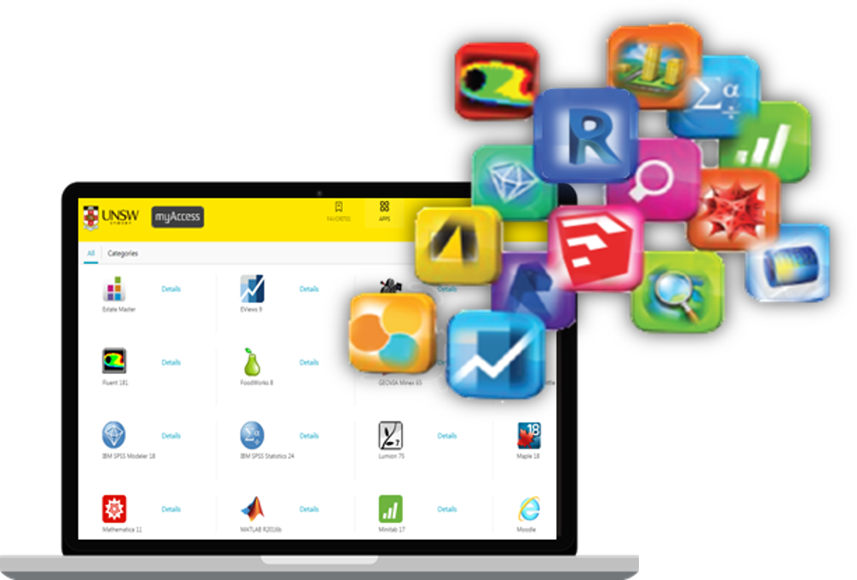
An introduction to myAccess
[INSERT APPLICATION NAME] is now available on myAccess. That means you can access [INSERT APPLICATION NAME] anywhere you have internet access using your own device.

Slide 3
Getting started with myAccess
Step Three
Step Two
Step One
Use myAccess File Manager to transfer your files to your H: drive. This will optimise the performance of myAccess.
Save files/datasets to your H: drive whilst on campus – it’ll be quicker.
Logon to myaccess.unsw.edu.au and start using your applications!
PC & MAC users when you logon to myAccess for the first time you will be prompted to install a Citrix Receiver.
Android & iOS users you can download the receiver from the App or Play stores.
Don’t forget to refer to the user guide for you operating system see: www.myAccess.unsw.edu.au/user-guides

Slide 4
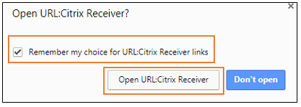
Troubleshooting your Citrix Receiver
If for some reason there is an issue with your Citrix Receiver for example PC and MAC users you aren’t prompted to install the receiver when you logon to myAccess for the first time, clear your cookies and relaunch myAccess.
TIP: when installing the receiver click on the ‘Open URL Citrix Receiver’ button not the blue ‘Don’t open’ button.

Slide 5
Tips
There are more than 90 applications available on myAccess. Access to some of these apps is restricted based on course enrolment. Logon to see which applications you can access!
myAccess applications must not be used for commercial or revenue generating activities, or to facilitate research.
You cannot access, manage or transmit any data that is classified as ‘Sensitive’ or ‘Highly Sensitive’ in myAccess (see UNSW Data Classification Standard for more information).

Slide 6
Where can I go for help?
If you have any questions or issues please contact the IT Service Centre on itservicecentre@unsw.edu.au or (02) 9385 1333. You can also bring your device to one of the IT Assistance Counters.

